Slide 1
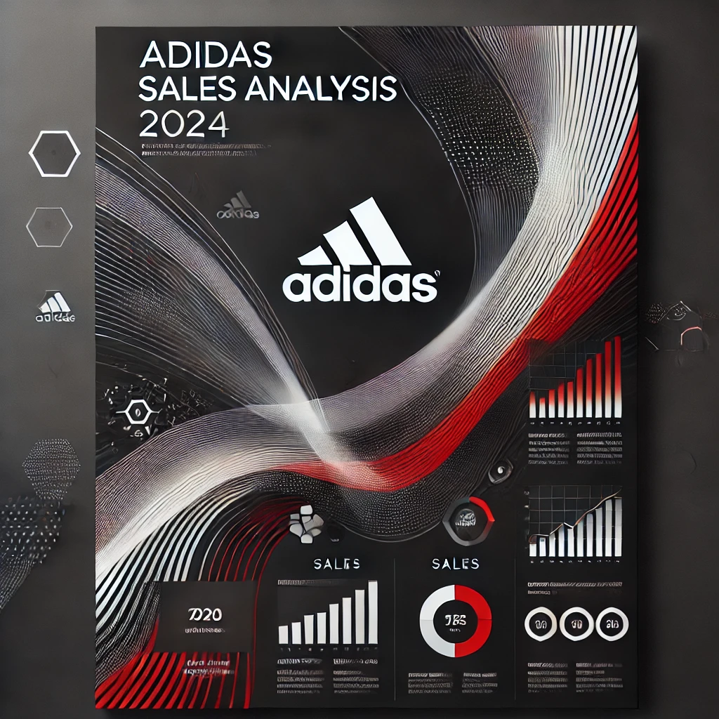
Adidas Sales Analysis
- By Udit Bahuguna
Udit Bahuguna

Slide 2

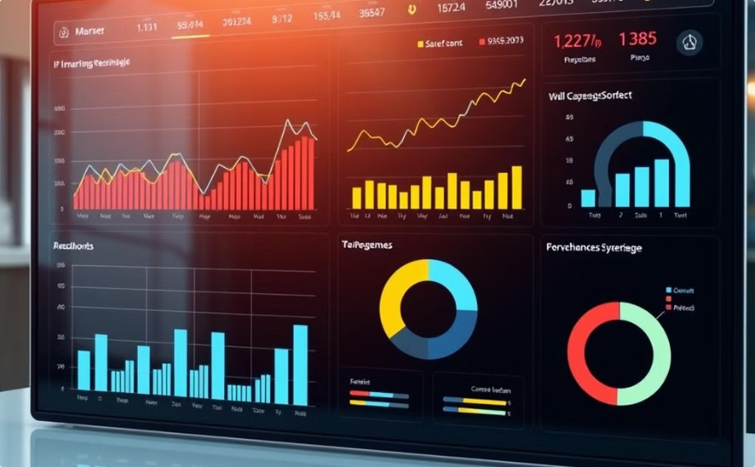
Comprehensive Overview
Interactive Tool
The Adidas Sales Dashboard provides a detailed view of global sales performance, tracking key metrics across regions, product categories, and retail channels. You can also analyze customer demographics.
This interactive tool lets executives explore specific data points, like seasonal sales trends and product category performance. Charts and graphs visualize key trends to inform data-driven decisions.
Udit Bahuguna

Slide 3

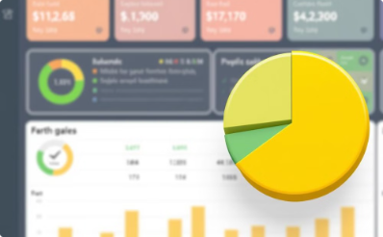


Total Sales and Profitability
Total Sales
Total Profit
Units Sold
Price per Unit
The Adidas sales dashboard reports a total sales figure of $899.9 million, showcasing the brand's strong performance in the market. This metric provides a high-level understanding of the overall revenue generated during the reporting period.
The dashboard also highlights a total profit of $332.1 million, indicating a healthy 42% average margin. This data point helps executives assess the profitability of Adidas' operations and identify opportunities for further optimization.
The total units sold figure of 2.5 million provides insights into the scale of Adidas' consumer reach and the popularity of its products. This metric can inform product development, pricing strategies, and inventory management decisions.
The average price per unit of $436.3 thousand reflects Adidas' positioning as a premium brand. This data point can guide pricing adjustments, product line expansions, and the overall brand positioning strategy.

Slide 4


Customer Demographics
Age and Gender
Income and Location
Adidas' customer base spans a diverse range of ages, incomes, and geographic regions. The dashboard provides insights into this demographic breakdown, enabling data-driven targeting and personalized marketing strategies.
By analyzing factors such as age, gender, income level, and location, Adidas can identify key customer segments and tailor their offerings to meet evolving needs.

Slide 5
Seasonal Sales Trends
Consistent Demand
Summer Peak
While the monthly sales figures fluctuate, the dashboard demonstrates a relatively consistent demand for Adidas products throughout the year, with sales ranging from $70 million to $92 million across the months. This stability allows the company to plan production, inventory, and marketing strategies effectively.
The dashboard reveals a significant sales peak in July, reaching $92 million. This trend suggests strong seasonal demand for Adidas products during the summer months, potentially driven by factors like outdoor activities, vacation wear, and athletic events.
1
2
3
Holiday Surge
December also shows a sales spike of $86 million, reflecting the high-demand holiday shopping season. Adidas likely benefits from increased consumer spending and gift-giving during this time of the year.

Slide 6



Regional Sales Insights
Midwest Dominance
Coastal Strength
Western Opportunity
The dashboard reveals that the Midwest region is the top-performing market for Adidas, generating $270 million in sales. This strong presence in the central United States suggests a well-established brand reputation and effective distribution networks in this area.
The Northeast, South, and Southeast regions collectively contribute between $136 million and $186 million in sales, demonstrating Adidas' significant foothold in the coastal markets of the United States. This geographic diversity allows the brand to capitalize on various consumer preferences and shopping behaviors.
The West region, which includes states like California, Washington, and Oregon, generated $145 million in sales. While still a sizable market, this figure suggests potential for further growth and expansion in the western United States, where Adidas may have room to strengthen its brand presence and distribution networks.

Slide 7


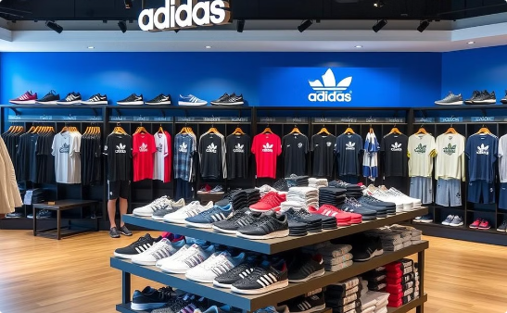
Product Category Performance
Men's Street Footwear
Women's Apparel and Footwear
Expanding Product Offerings
Men's Street Footwear is the top-selling product category for Adidas, generating $208.88 million in sales. This data point highlights strong consumer demand for Adidas' casual and lifestyle footwear targeted at male consumers.
Women's Apparel and Women's Street Footwear are also top performers, contributing $179.04 million and $153.67 million in sales, respectively. Adidas effectively caters to its female consumer base across both clothing and footwear categories.
The dashboard insights help Adidas guide future product development, marketing, and inventory management strategies. By understanding the sales performance of different product lines, the company can optimize its portfolio and allocate resources effectively.

Slide 8
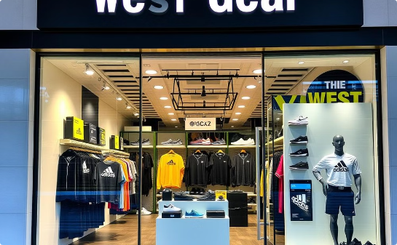
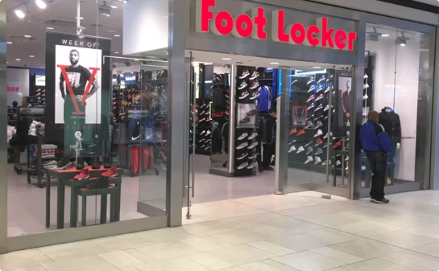
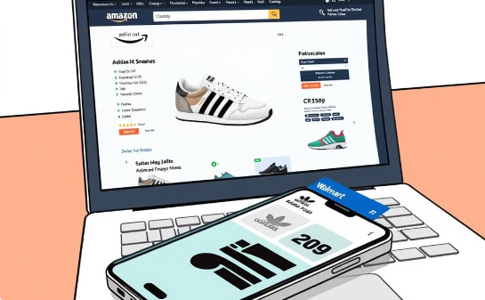
Retail Channel Performance
West Gear Leads
Foot Locker's Strength
E-Commerce Opportunities
The dashboard reveals that West Gear is the top-performing retailer for Adidas, generating $242.96 million in sales. This data suggests that West Gear's strategic positioning, product selection, and customer experience have resonated well with Adidas' target consumers.
Foot Locker, a well-established specialty retailer, follows closely with $220.09 million in Adidas sales. This partnership highlights the continued importance of traditional brick-and-mortar channels in the brand's distribution and sales strategy.
While Amazon and Walmart show lower sales volumes of $77.7 million and $74.56 million, respectively, these e-commerce platforms represent important growth opportunities for Adidas to reach a broader consumer base and expand its direct-to-consumer initiatives.

Slide 9

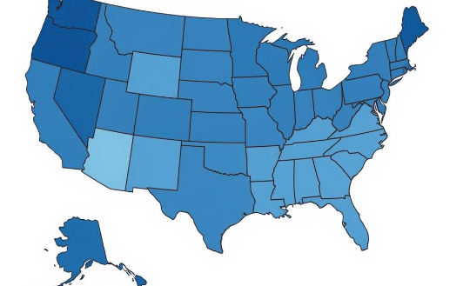

Unlocking Geographical Insights
Sales Hotspots
Untapped Potential
Informed Decisions
The dashboard reveals top-selling states like New York, California, and Illinois, informing targeted marketing and distribution strategies.
Areas with lower sales offer potential for growth. Identifying these regions informs expansion strategies and tailored marketing.
Detailed geographical data enables informed decisions on resource allocation, inventory management, and go-to-market approaches.

Slide 10




Driving Adidas' Future Growth
Goal-Setting
Strategic Alignment
Data-Driven Decisions
Accelerated Growth
The insights gleaned from the Adidas Sales Dashboard empower executives to set strategic, data-driven goals that align with the brand's overall growth objectives. These goals can encompass target sales figures, market share expansion, and the optimization of profit margins.
By understanding the performance of different regions, product categories, and retail channels, Adidas can ensure its strategies and resource allocation are aligned with the areas of highest potential. This alignment fosters more efficient and effective execution across the organization.
The comprehensive data and visualizations provided in the dashboard enable Adidas executives and sales managers to make informed, data-driven decisions. This data-driven approach supports the company's ability to respond to market trends, optimize operations, and capitalize on emerging opportunities.
By leveraging the insights from the Adidas Sales Dashboard, the company can develop and implement strategies that drive sustainable growth, strengthen its market position, and enhance its profitability. This data-driven approach positions Adidas for long-term success in the competitive sportswear industry.

Slide 11
Conclusion
Total Sales amount to $899.9M, with a Total Profit of $332.1M and 2.5M Units Sold.
The Price Per Unit is approximately $436.3K, and the Average Margin stands at 42%.
Monthly Sales show fluctuations, with peaks in August (92M) and December (86M).
Top Sales State are concentrated in New York and surrounding states.
Regional Sales highlight the Midwest (270M) as the top-performing region.
Men's Street Footwear is the leading product category, contributing 208.88M in sales.
West Gear (242.96M) is the top retailer, followed by Foot Locker and Sports Direct.

